Slide 1
Making this resource work for you
Prior to teaching this lesson, please refer to the ‘Unit Overview and Planning Document’.
Further guidance on planning Science Mastery lessons can be found in the detailed planning guidance document.
Refer to the ‘notes’ section on each slide for useful information, including suggested expositions, pedagogical content knowledge, suggested questions, answers and more. Consider using presenter mode so you can see this guidance throughout the lesson.
The introduction slides can be adapted to suit your teaching style and the needs of your class.
Before the lesson, adapt the fix-it slide to address any misconceptions identified in the previous lesson’s exit ticket.
Choose from the suggested activities to suit your class. The intention is not that you complete all of these, but that you select those which ones are most appropriate for your students. It may be appropriate to further adapt activities for your students.
These lessons are designed to occupy approximately 1 hour. To adapt for a shorter or longer lesson duration we advise you to adapt the activity section accordingly.
Please consider using the final slide to send feedback about this lesson or examples of PowerPoints that you have adapted to our design team. Your feedback is used to improve Science Mastery for all of our teachers and students. We appreciate all suggestions and comments.
Thank you for reading!
The Science Mastery Team

Slide 2

(HT) Taking it Further: Condensation Polymerisation
Answer the questions below.
Define a polymer.
Describe what happens during addition polymerisation.
Explain why alkanes cannot be monomers.
State the chemical formula of water.
Describe the bonding in water.
A long molecule made up of many repeating units.
The C=C double bonds of monomers are broken so monomers can join together to form a polymer.
They are saturated so cannot make more bonds with other molecules.
H₂O
An oxygen atom covalently bonds to two hydrogen atoms, so that each atom achieves a full outer shell.
Notes:
Big idea: Reactions rearrange matter
Foundation: Calculate the relative formula mass of water.
Stretch: Explain why water has a relatively low melting and boiling point.
Answers:
Foundation: 16+(2x1) = 18
Stretch: The intermolecular forces between molecules of water are weak so require little energy to overcome.

Slide 3
(HT) Taking it Further: Condensation Polymerisation
Do Now:
Define a polymer.
Describe what happens during addition polymerisation.
Explain why alkanes cannot be monomers.
State the chemical formula of water.
Describe the bonding in water.
Drill:
Name the functional group found in alcohols.
Name the functional group found in carboxylic acids.
Name the type of compound formed when an alcohol reacts with a carboxylic acid.
Notes:
Drill answers:
Hydroxyl group
Carboxyl group
Ester

Slide 4
(HT) Taking it Further: Condensation Polymerisation
Read Now:
For addition polymerisation to take place, monomers must contain a C=C double bond. This double bond is broken open to allow the monomer to bond with other monomers to make the polymer chain. In condensation polymerisation, the monomers do not require a C=C double bond, but the monomers must each have two functional groups. Simple polymers can be made through condensation polymerisation reactions where two monomers contain two of the same functional group. This is how materials such as polyester are made. Condensation polymerisation is also the reaction through which proteins are synthesised from amino acids.
State what is required for monomers to undergo addition polymerisation.
State what is required for monomers to undergo condensation polymerisation.
Give an example of a polymer made from condensation polymerisation.
Identify the monomers and polymers when proteins are synthesised from amino acids.
Notes:
Answers:
Monomers must have a C=C double bond
Monomers must contain two function groups
Polyester, proteins
Monomers: amino acid, polymer: protein

Slide 5
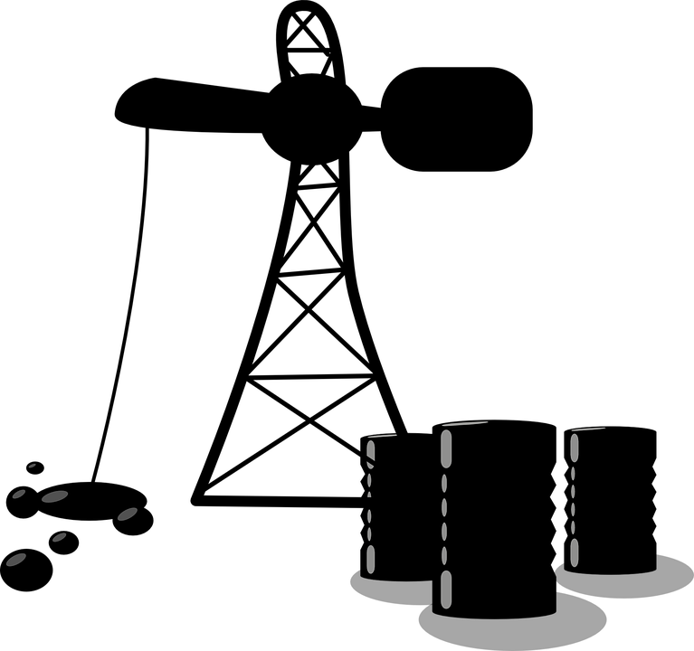
C5.1.14
02/04/2024
(HT) Taking it Further: Condensation Polymerisation
C5.1.10 Taking it Further: Carboxylic Acids
C5.1.11 Taking it Further: Esters
C5.1.12 Polymers
C5.1.13 Taking it Further: Addition Polymerisation
C5.1.14 Taking it Further: Condensation Polymerisation
C5.1.15 Taking it Further: Naturally Occurring Polymers
C5.1.1 Prior Knowledge Review
C5.1.2 Crude Oil and Hydrocarbons
C5.1.3 Fractional Distillation
C5.1.4 Combustion of Hydrocarbons
C5.1.5 Cracking
C5.1.6 Taking it Further: Alkenes
C5.1.7 Taking it Further: Alcohols
C5.1.8 Taking it Further: Producing Ethanol by Fermentation
C5.1.9 Taking it Further: Producing Ethanol from Ethene
Notes:
Big Idea: Structure Determines Properties
In this lesson, which is for higher tier separate science students, students will review the different homologous series and their functional groups, then compare the processes of addition and condensation polymerisation. In the following lesson, they will look at how naturally occurring polymers are made from condensation polymerisation.
Suggested Hook:
What is condensation? What process does it refer to?

Slide 6

Following this lesson, students will be able to:
Identify the by-products of condensation polymerisation reactions
Compare the processes of addition polymerisation and condensation polymerisation
Key Words:
polymer
monomer
polyester
condensation
polymerisation
Notes:
Guidance:
See unit overview document and planning guidance to see how these objectives are typically assessed at GCSE, including examples of what students should be able to do following this lesson.
Planning for different needs:
The learning objectives given on this slide are suggested based on the most common requirements for exams, however they can be adapted based on the needs of different classes.
For best practice, the unit preparation booklet should be used to determine the appropriate focus of lessons within the unit.
While it is not possible to explicitly split content into levelled grades, we recommend that lesson objectives can be classified as critical, core or stretch.
Critical: the content or skill is essential for all students to be able to progress.
Core: the content or skill is important for students to progress, but other opportunities may be available to revisit it.
Stretch: the content or skill may not be essential for all students but is important for students aiming for the highest grades.
Key skill: this is a crucial skill being developed in this unit as part of the skill mapping
C5.1.14 Lesson Objectives:
Critical: Identify the by-products of condensation polymerisation reactions
Core: Compare the processes of addition polymerisation and condensation polymerisation

Slide 7
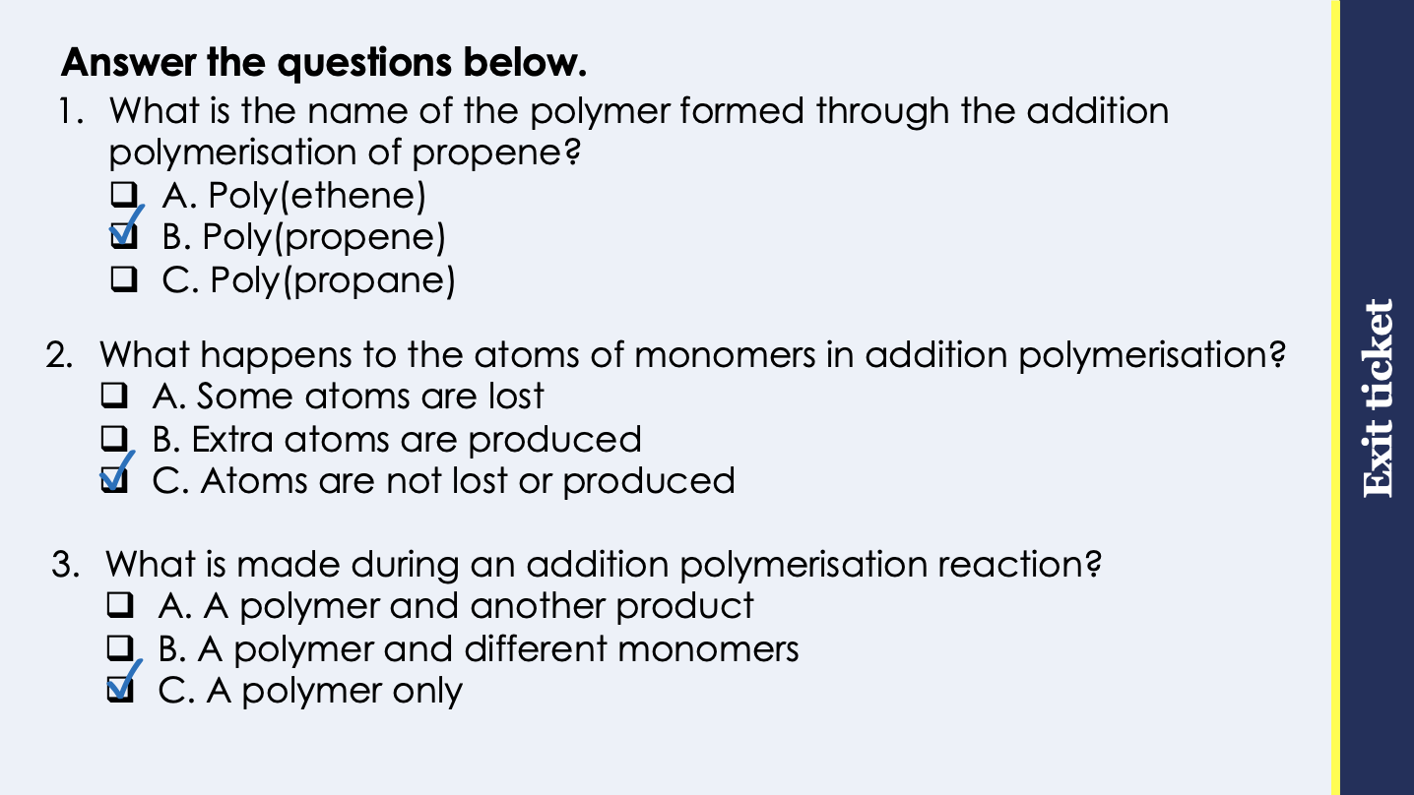
This is the fix-it portion of the lesson
The fix-it is an opportunity to respond to gaps in knowledge, especially those identified by the pre-unit quiz.
The teacher should customise this slide as needed, to facilitate
reteach, explanation, demonstration or modelling of ideas and concepts that students have not yet grasped or have misunderstood.
practise answering specific questions or of key skills.
redrafting or improving previous work.
Notes:
Purpose: to spend time on any gaps identified in previous learning from previous exit ticket.
Guidance from previous exit ticket:
Q1. Answer: B
If students answer A, they have just assumed that poly(ethene) is the general polymer rather than a specific polymer. If students answer C, they have not identified the importance of the monomer being an alkene. To fix-it, give students practice naming polymers from monomers and explain why alkanes cannot be monomers.
Q2. Answer: C
If students answer A, they have made the common mistake of confusing bonds being broken with atoms being lost. If students answer B, they have not understood that the atoms themselves do not change, they are simply rearranged. To fix it, review what happens during addition polymerisation and explain why it can be described as a chemical reaction.
Q3. Answer: C
If students answer A or B, they are not clear that addition polymerisation only produces a polymer. This will be revisited in the next lesson where students will compare the processes of addition and condensation polymerisation. To fix it, review what happens during addition polymerisation.

Slide 8
Condensation Polymerisation
H H
H H
O
O
H O
C C
O H
+
C
C
C C
H O
O H
H H
H H
Ethandiol
Butanedioic acid
Polyester
H H
O
H H
O
H H
→
O
C C
O
C
C C
C
O
C C
O
H H
H H
H H
+
H₂O
+
H₂O
n
Notes:
Suggested exposition:
In the last lesson, we looked at addition polymerisation.
What happens during addition polymerisation?
Monomers join together to make a polymer.
Are there any other products?
No.
What do each of the monomers need to contain?
A C=C double bond. It is this bond that is broken open and allows the monomers to bond with neighbouring monomers to make the polymer chain.
In this lesson, we are going to look at a different process of polymerisation: condensation polymerisation.
Let’s go through the process.
Animate ethandiol.
For condensation polymerisation to take place, the monomers each need to contain two functional groups. The simplest polymers are made from two monomers that contain two of the same functional group. In this case, we have ethandiol.
What are the functional groups?
There is a hydroxyl (OH) group on either end of the molecule.
This is why it is called ethandiol as there are two of the functional group that make it an alcohol.
This can react with another monomer, with its own functional groups.
Animate butanedioic acid.
What are the functional groups?
There is a carboxyl (COOH) group on either end of the molecule.
This is why it is called butanedioic acid as there are two of the functional group that make it a carboxylic acid.
What is produced when an alcohol reacts with a carboxylic acid?
An ester.
What is the other product of the reaction?
Water.
We can see from the functional groups that when these molecules react to form an ester, the hydrogen atom from the alcohol’s functional group and the OH from the carboxylic acid’s functional group bond to make a water molecule.
Animate product.
This is the same process that happens when an ester is formed. But the difference is that each of these monomers has a functional group on either end of the molecule, so rather than just making a single ester molecule, both ends of their molecules react and can continue to do this along the chain. This forms a polyester, as it has formed a long chain of esters.
This represents just a section of the polymer that is produced, so that we can see what is happening to the functional groups. Wherever the functional groups have bonded, a water molecule will be produced.
Just as we would use brackets to show a section of a polymer made through addition polymerisation, we would do the same for a polymer produced through condensation polymerisation.
Animate brackets.

Slide 9
Condensation Polymerisation
HO
CH₂
CH₂
OH
+
HOOC
CH₂
CH₂
COOH
→
CH₂
CH₂
O
CH₂
CH₂
CO
O
CO
O
n
+
2n H₂O
HO
OH
+
HOOC
COOH
→
CO
O
O
CO
O
+
2n H₂O
n
Notes:
Suggested exposition:
It can be quite complicated to show condensation polymerisation reactions with full displayed formulae, so we can represent them in simpler ways.
There are different ways we can do this.
Firstly, we can use the simplified formulae for the CH2 groups.
Animate first section.
In this way of representing the reaction, we have simplified the full displayed formula to just show the CH2 groups in the chains.
We can also make it even simpler using symbols.
Animate second section.
Both of these represent the same reaction as on the previous slide, they can just be easier to represent.
We know that a water molecule is made between ends of each monomer molecule, so for a given molecule (provided it is not at the end of the chain), it will produce two water molecules for every monomer. We can represent this as 2n H₂O.

Slide 10
Condensation Polymerisation: Summary
Condensation polymerisation involves monomers with two functional groups.
When these types of monomers react, they join together, usually losing small molecules such as water, and so the reactions are called condensation reactions.
The simplest polymers are produced from two different monomers with two of the same functional groups on each monomer.
Notes:
Suggested exposition:
Now let’s review the features of condensation polymerisation with a quick summary.
In condensation polymerisation, the monomers must have two functional groups. These are normally drawn at either ends of the monomer molecule. When these monomers react, they join together where their functional groups meet. This also produces a small molecule. Most often, this is water. This is why these reactions are called condensation reactions.
The simplest polymers, such as polyester, are made from two different monomers, each of which has two of the same functional group on either end of the monomer molecule. For example, ethandiol has two hydroxyl groups on either end and butanedioic acid has two carboxyl groups on either end.

Slide 11

Can you explain the difference between these two process?
Addition polymerisation
What do the monomers or reactants need to have in each?
What are the products of each?
Do they have anything in common?
Condensation polymerisation
Notes:
Suggested points:
Both involve monomers reacting to make a polymer.
Addition polymerisation only produces a polymer but condensation polymerisation produces a polymer and a small molecule, usually water.
The monomers for addition polymerisation must have a C=C double bond but the monomers for condensation polymerisation do not require this. Instead they need two functional groups.
Suggested guidance:
Talk tasks can be used in a variety of ways to suit the particular needs of the students you are teaching. Through exchanging views with others, students develop their understanding of the science beyond what could be achieved individually.
Science classrooms that successfully integrate talk have the following features:
Science talk is a regular feature of lessons and is woven into classroom activities.
Students are paired or grouped strategically by the teacher to ensure productive interaction. This might take into consideration the students’ proficiency of the English language, how encouraging they might be to peers and their attainment in the topic. It’s a good idea to consider these pairings in the class seating plan.
Students are encouraged and supported to talk, but are not forced to talk.
The teacher should take on the role of a facilitator, engaging with conversations where necessary and encouraging or steering the conversation where needed.
Students are encouraged to use the language they have to express their ideas (e.g., everyday language, imperfect English, native language), but also to incorporate science specific terminology where this is more accurate or has been taught.
6. Scientifically inaccurate ideas are not dismissed by the partner or teacher; open discussion and further investigation are relied on to help students construct ideas that support them to progress in their scientific understanding.
7. Guidelines for behaviour during talk tasks are explicit and frequently reviewed. Rules for students might be:
Listen carefully to your partner
Take turns talking.
Speak one at a time, without interrupting.
Politely agree or disagree and explain why.
Politely point out if your partner has used a scientific word incorrectly, if they have explained the science incorrectly, or if there is a more accurate way to describe something.
If confused, ask questions.
Stay focused on the discussion topic.
Respond to one another.

Slide 12




Which statements do you agree with?
Alkenes can be monomers for addition polymerisation
Addition polymerisation is a physical process while condensation polymerisation is a chemical reaction
Condensation polymerisation produces a polymer and a small molecule
Monomers for condensation polymerisation must contain one functional group
Notes:
Suggested points:
Blue: incorrect - both are chemical reactions
Yellow: correct
Green: correct
Pink: incorrect. They must contain two functional groups.
Suggested guidance:
Talk tasks can be used in a variety of ways to suit the particular needs of the students you are teaching. Through exchanging views with others, students develop their understanding of the science beyond what could be achieved individually.
Science classrooms that successfully integrate talk have the following features:
Science talk is a regular feature of lessons and is woven into classroom activities.
Students are paired or grouped strategically by the teacher to ensure productive interaction. This might take into consideration the students’ proficiency of the English language, how encouraging they might be to peers and their attainment in the topic. It’s a good idea to consider these pairings in the class seating plan.
Students are encouraged and supported to talk, but are not forced to talk.
The teacher should take on the role of a facilitator, engaging with conversations where necessary and encouraging or steering the conversation where needed.
Students are encouraged to use the language they have to express their ideas (e.g., everyday language, imperfect English, native language), but also to incorporate science specific terminology where this is more accurate or has been taught.
6. Scientifically inaccurate ideas are not dismissed by the partner or teacher; open discussion and further investigation are relied on to help students construct ideas that support them to progress in their scientific understanding.
7. Guidelines for behaviour during talk tasks are explicit and frequently reviewed. Rules for students might be:
Listen carefully to your partner
Take turns talking.
Speak one at a time, without interrupting.
Politely agree or disagree and explain why.
Politely point out if your partner has used a scientific word incorrectly, if they have explained the science incorrectly, or if there is a more accurate way to describe something.
If confused, ask questions.
Stay focused on the discussion topic.
Respond to one another.

Slide 13
Drill
Define a polymer.
Define a monomer.
State what the monomers need for condensation polymerisation to occur.
State the products of a condensation polymerisation reaction.
Name the functional group found in alcohols.
Name the functional group found in carboxylic acids.
Notes:
Purpose: This is a knowledge drill. The purpose of this is to check that the critical knowledge is secure before pupils move onto independent practice.
Suggested guidance: There are a range of ways this could be done depending on time and ability range of the class:
Mini whiteboards
As full sentences in exercise books
As short answers in exercise books
In the pupil workbook
As pair talk
As cold call

Slide 14
Drill answers
Long chain molecules made of many units
Small molecules that can be joined together to make a polymer.
Each monomer requires two functional groups.
A polymer and a small molecule (usually water) are formed.
Hydroxyl group
Carboxyl group
Notes:
Purpose: This is a knowledge drill. The purpose of this is to check that the critical knowledge is secure before pupils move onto independent practice.
Suggested guidance: There are a range of ways this could be done depending on time and ability range of the class:
Mini whiteboards
As full sentences in exercise books
As short answers in exercise books
In the pupil workbook
As pair talk
As cold call

Slide 15
I: Types of polymerisation
The formulae below show two monomers.
Explain what type of polymerisation would happen when many of the two monomers reacted.
HO
CH₂
CH₂
OH
+
HOOC
CH₂
CH₂
COOH
Both monomers contain two functional groups.
This means they would react in a condensation polymerisation reaction.
This would produce a polymer and water.
Notes:
Purpose: The I-We-You section aims to support pupils to build skills that they most commonly need when answering questions associated with this knowledge in the assessment. This section is also used to interleave other content we expect pupils to know at this stage of their education in order that they build a big picture of the science they are learning.
For the ‘I’ activity, the teacher should model how to answer the question. They can do this by narrating their thinking process aloud, and making links to learning earlier in the lesson explicit.
For the ‘we’ activity, the teacher and students work though a similar example together, in order to prepare students to be able to answer a similar question independently.
Opportunities for the ‘you’ activity – independent practise – occur in the activity portion of the lesson once the student is secure enough to process independently.

Slide 16
We: Types of polymerisation
The formulae below show two monomers.
Explain what type of polymerisation would happen when many of the two monomers reacted.
CH₂
CH₂
+
CH₂
CH₂
Both monomers contain a double bond.
This means they would react in an addition polymerisation reaction.
This would produce a polymer only.
Notes:
Purpose: The I-We-You section aims to support pupils to build skills that they most commonly need when answering questions associated with this knowledge in the assessment. This section is also used to interleave other content we expect pupils to know at this stage of their education in order that they build a big picture of the science they are learning.
For the ‘I’ activity, the teacher should model how to answer the question. They can do this by narrating their thinking process aloud, and making links to learning earlier in the lesson explicit.
For the ‘we’ activity, the teacher and students work though a similar example together, in order to prepare students to be able to answer a similar question independently.
Opportunities for the ‘you’ activity – independent practise – occur in the activity portion of the lesson once the student is secure enough to process independently.

Slide 17
You: Types of polymerisation
The formulae below show two monomers.
Explain what type of polymerisation would happen when many of the two monomers reacted.
HOOC
COOH
+
HO
OH
Both monomers contain two functional groups.
This means they would react in a condensation polymerisation reaction.
This would produce a polymer and water.
Notes:
Purpose: The I-We-You section aims to support pupils to build skills that they most commonly need when answering questions associated with this knowledge in the assessment. This section is also used to interleave other content we expect pupils to know at this stage of their education in order that they build a big picture of the science they are learning.
For the ‘I’ activity, the teacher should model how to answer the question. They can do this by narrating their thinking process aloud, and making links to learning earlier in the lesson explicit.
For the ‘we’ activity, the teacher and students work though a similar example together, in order to prepare students to be able to answer a similar question independently.
Opportunities for the ‘you’ activity – independent practise – occur in the activity portion of the lesson once the student is secure enough to process independently.

Slide 18
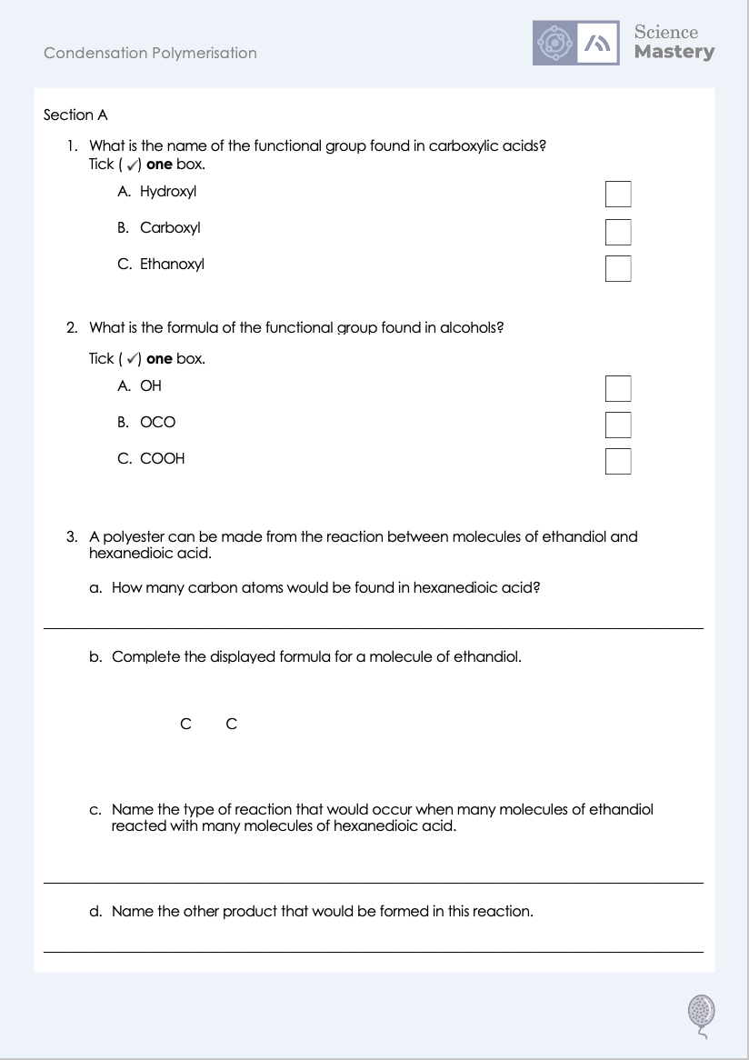
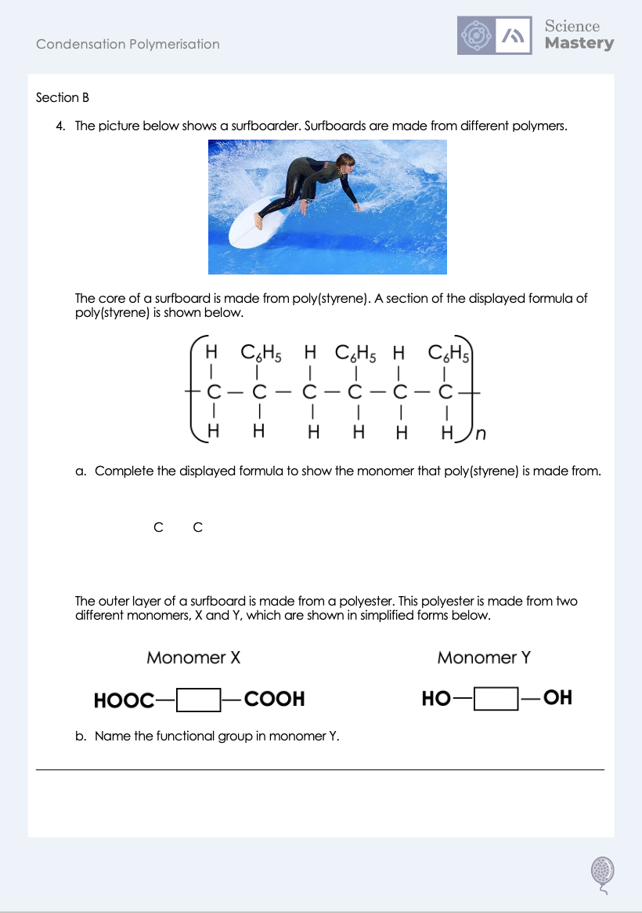
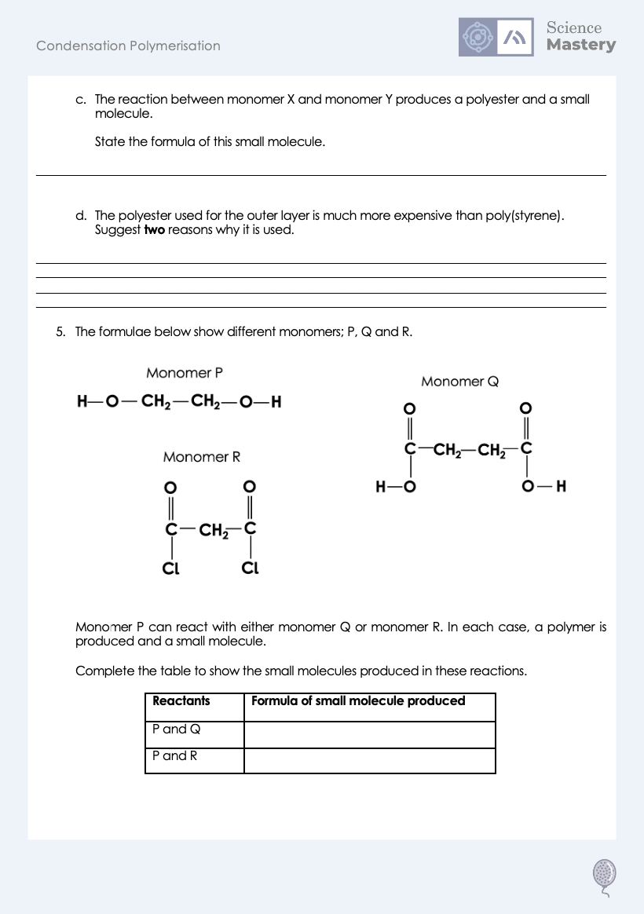
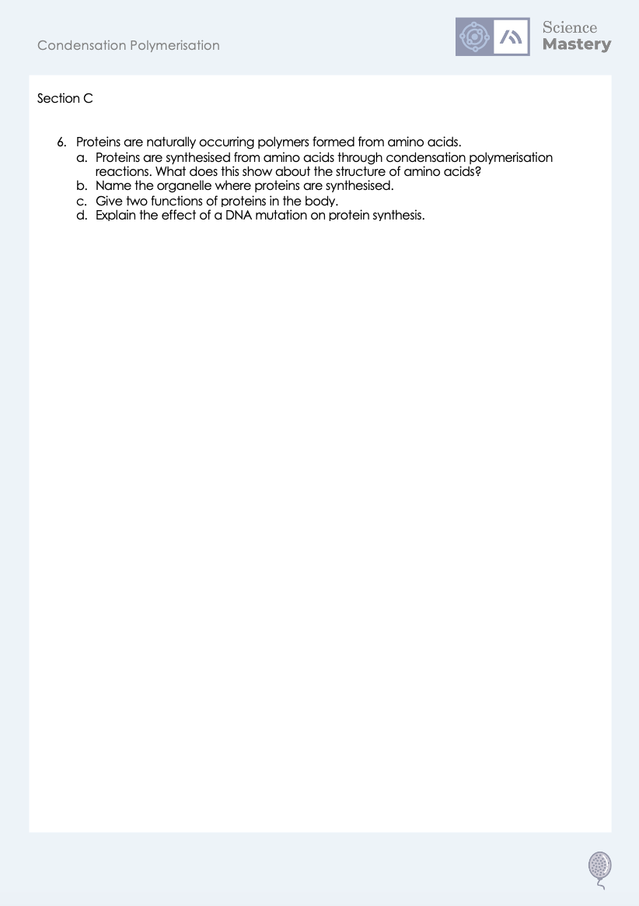
Worksheet

Slide 19
Answers
1. B - Carboxyl
2. A - OH
3a. 6
3b.
H H
H O
C C
O H
H H
3c. Condensation polymerisation
3d. Water

Slide 20
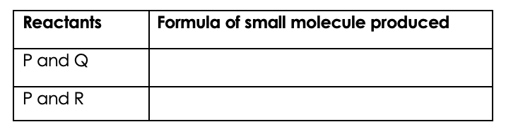
Answers
4a.
H C₆H₅
4d. Any two from:
It is waterproof
It is harder
It is tougher
It is more rigid
C C
H H
5.
H₂O
4b. Hydroxyl group
HCl
4c. H₂O

Slide 21
Answers
6a. Amino acids contain two functional groups.
6b. Ribosomes
6c. Enzymes, antibodies, hormones, structures such as collagen etc.
6d. Most mutations have no effect on protein synthesis but some mutations that cause a change in DNA structure, causing it to code for a protein with a different shape and affecting its function.

Slide 22
Answer the questions below.
What is required for monomers to react in condensation polymerisation?
A. The monomers must contain a C=C double bond
B. The monomers must contain water
C. The monomers must contain two functional groups
✓
What small molecule is usually produced through condensation polymerisation?
A. A polymer
B. Water
C. Carbon dioxide
✓
Which of these is made through condensation polymerisation?
A. Polyester
B. Poly(ethene)
C. Amino acids
✓
Notes:
Q1. Answer: C
If students answer A, they have confused the monomers that react in addition and condensation polymerisation. If students answer B, they have confused the requirements of the reactant monomers with the product. To fix-it, review the differences in the monomers for addition and condensation polymerisation.
Q2. Answer: B
If students answer A, they have incorrectly suggested that a polymer is a small molecule, which is a common error in exam answers for this question. If students answer C, they have not identified that water is the most commonly made small molecule. To fix it, review what happens during condensation polymerisation and show how water is produced from the functional groups.
Q3. Answer: A
If students answer B, they are not clear on the difference between addition and condensation polymerisation. If students answer C, they have not recognised that amino acids are the monomers. To fix it, review an example of a condensation polymerisation reaction.

Slide 23
Lesson C5.1.14
What was good about this lesson? | What can we do to improve this lesson?
Send us your feedback by clicking this link
or by emailing sciencemastery@arkonline.org
Thank you!

